Slide 1
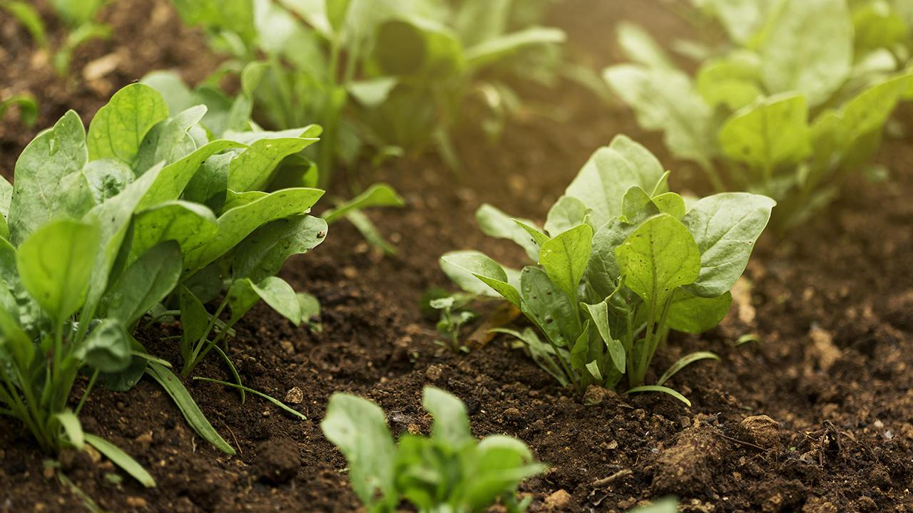
CROP PRODUCTION ANALYSIS IN INDIA
Project Report
Technologies: Data Analytics
Presented By: Arundhati Rothe

Slide 2
Project Details
Project Title | Crop Production Analysis In India
Tools Used | Jupyter Notebook , Tableau
Domain | Agriculture
Project Difficulty Level | Advance
Programming Language Used | Python

Slide 3

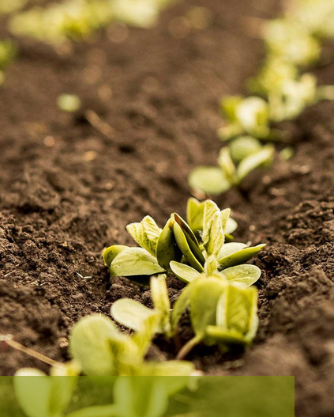
Objective
The primary objective of this project is to conduct a comprehensive analysis of crop production in India to gain insights into the agricultural landscape of the country.
By examining various factors such as state-wise production, district-wise patterns, crop trends over time, production-to-area ratios, and state-wise comparisons of top crops, the aim is to provide stakeholders with actionable insights to optimize agricultural practices, enhance productivity, and ensure food security across different regions of India.
Through this analysis, the project seeks to contribute to informed decision-making in the agricultural sector, enabling policymakers, farmers, and other stakeholders to make data-driven interventions for sustainable crop production and rural development.

Slide 4

Problem Statement
The Agriculture business domain, as a vital part of the overall supply chain, is expected to highly evolve in the upcoming years via the developments, that are taking place on the side of the Future Internet. This paper presents a novel Business-to-business collaboration platform from the agri-food sector perspective, which aims to facilitate the collaboration of numerous stakeholders belonging to associated business domains, effectively and flexibly.
This dataset provides a huge amount of information on crop production in India ranging from several years. Based on the Information the ultimate goal would be to predict crop production and find important insights highlighting key indicators and metrics that influence crop production.

Slide 5
DATA DESCRIPTION
Size of data:- 246091 rows and 7 columns
Dimensionality:- 7
Feature description(attributes):- State_Name, District_Name, Crop_Year, Season, Crop, Production
Nominal(discrete):- State_Name, District_Name, Crop_Year, Season, Crop
Interval(Continuous):- Area, Production
Independent features:- State_Name, District_Name, Crop_Year, Season, Crop, Area
Dependent features:- Production
DATA QUALITY
Noise:- No such extraneous object is shown that would modify with the original value.
Outliers:- Outliers are observed in the box plot as explained later in the documentation.
Missing values:- There are 3730 missing values in the Production column otherwise no other columns have missing values.
Duplicate data:- No duplicate rows are present in the dataset

Slide 6


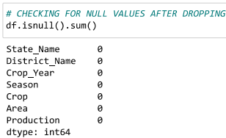


DATA PREPROCESSING
Dataset provides information on crop production in India ranging Attributes present in the data from 1997 to 2015.
Based on the Information the ultimate goal would be to predict crop metrics that influence crop production.

Slide 7
DATA PREPROCESSING
Approach:
Python: Used for Data Cleaning" Python”
Tableau: For Visualization
Link to Dataset: https://drive.google.com/file/d/1b3E1vpDSYpHe8YlNs3jkt30Lx6acf0Uo/view
Link to Tableau: https://public.tableau.com/shared/QGJJ8J9DK?:display_count=n&:origin=viz_share_link

Slide 8
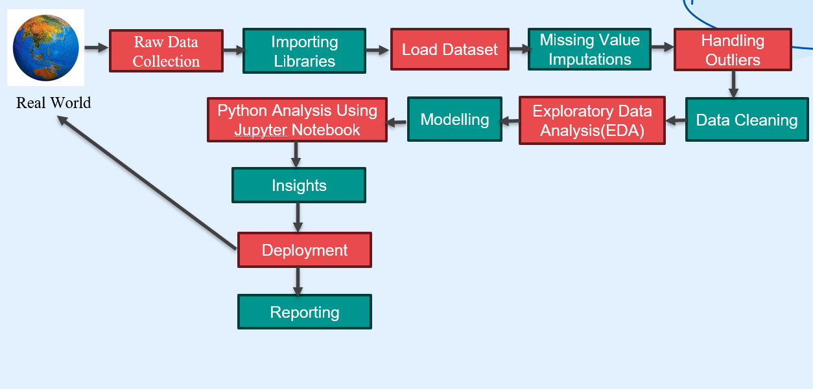
Architecture

Slide 9
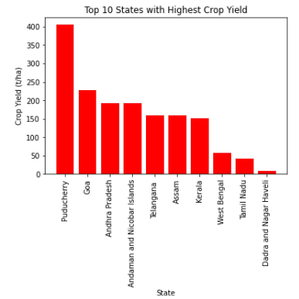
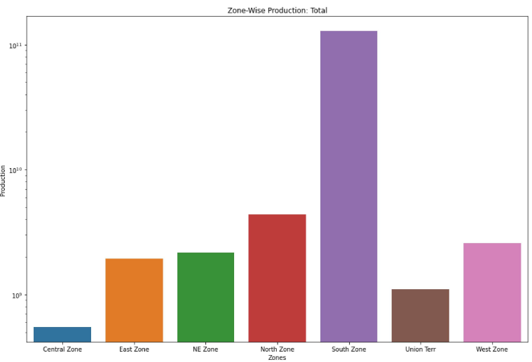
Insights
A bar chart of top 10 states with highest crop yield
Zonal distribution of crops

Slide 10
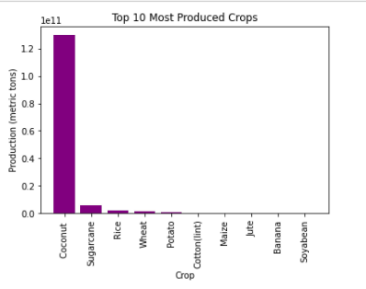
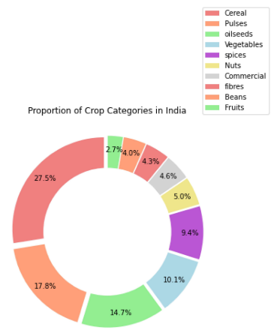
Insights
Different proportion of Crop Categories for India
We can see from the above graph that Coconut, Sugarcane,Rice, Wheat and Potato are the most produced crops. Coconut is at no. 1 among them.

Slide 11
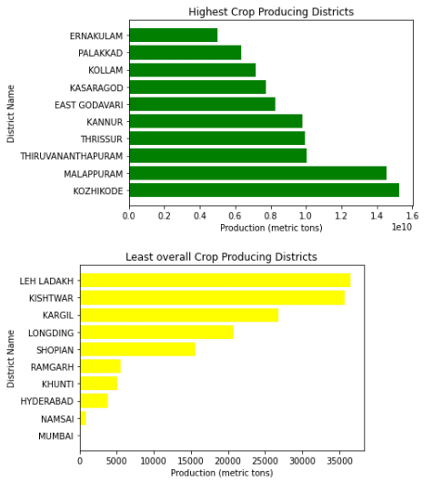
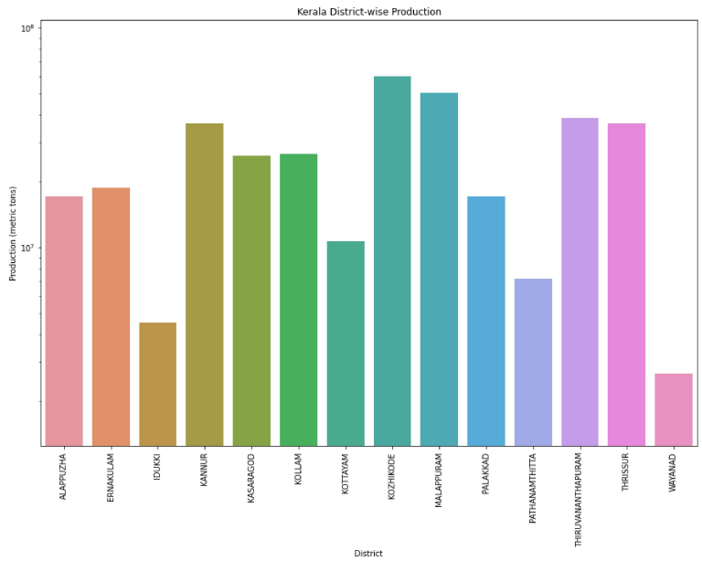
Analyzing the district zones in Kerala which give the highest production
Most and Least Crop-producing districts are KOZHIKODE and Mumbai respectively.

Slide 12
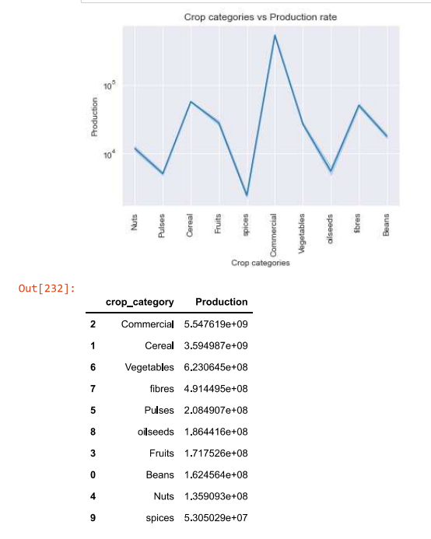
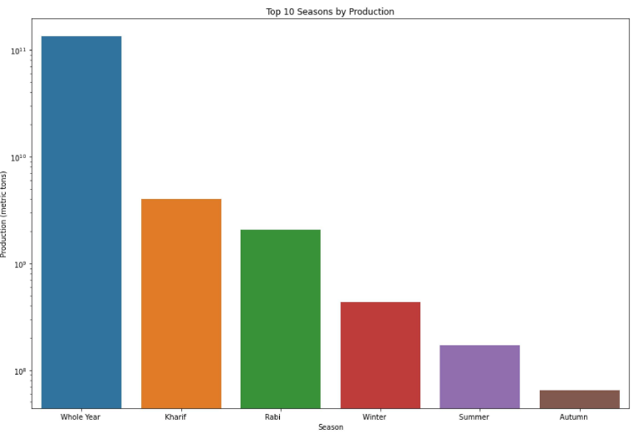
Analyzing season-wise productions
Crop categories and their Production rate

Slide 13
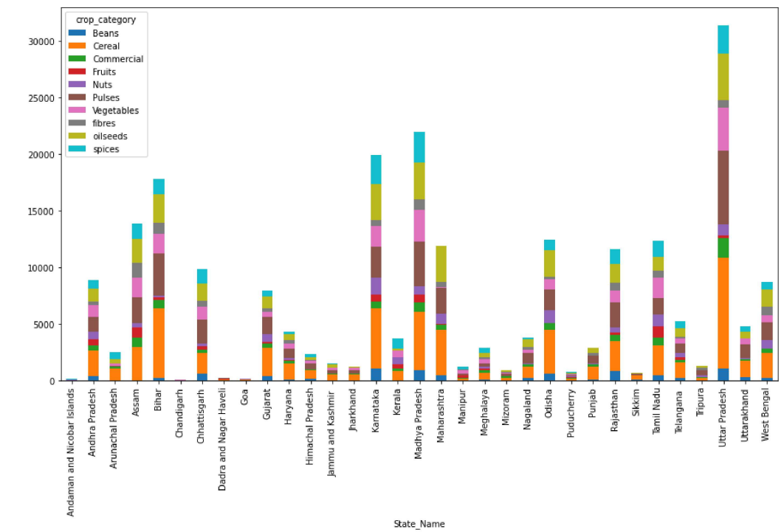
State that dominates in crop production by producing a variety of crop categories

Slide 14
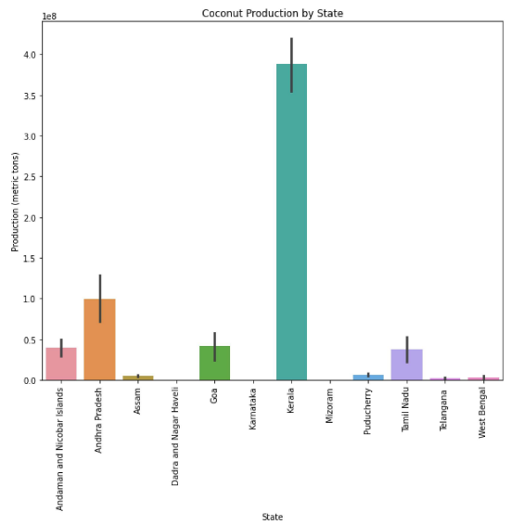
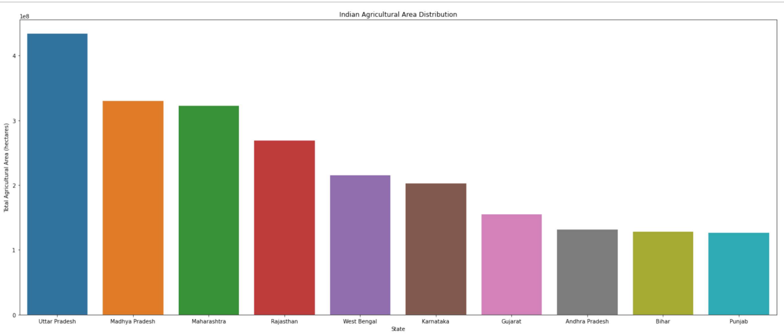
Result: The top crop-producing states based on Area are Uttar Pradesh followed by Madhya Pradesh and Maharashtra
A bar plot showing coconut production by state

Slide 15
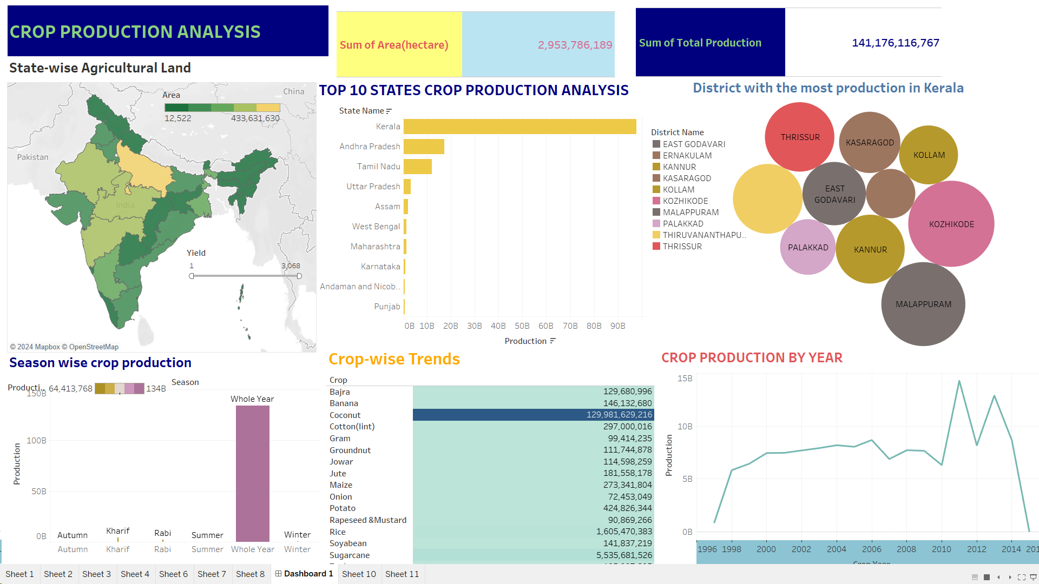
My Dashboard: https://public.tableau.com/shared/QGJJ8J9DK?:display_count=n&:origin=viz_share_link

Slide 16
Conclusion
In summary, the crop production analysis for India reveals diverse patterns in agricultural output across states and districts. Insights into crop trends over time, production-to-area ratios, and state-wise comparisons of top crops provide valuable information for stakeholders. Understanding these dynamics is crucial for optimizing resource allocation, informing policy decisions, and promoting sustainable agricultural development in the country.

Slide 17
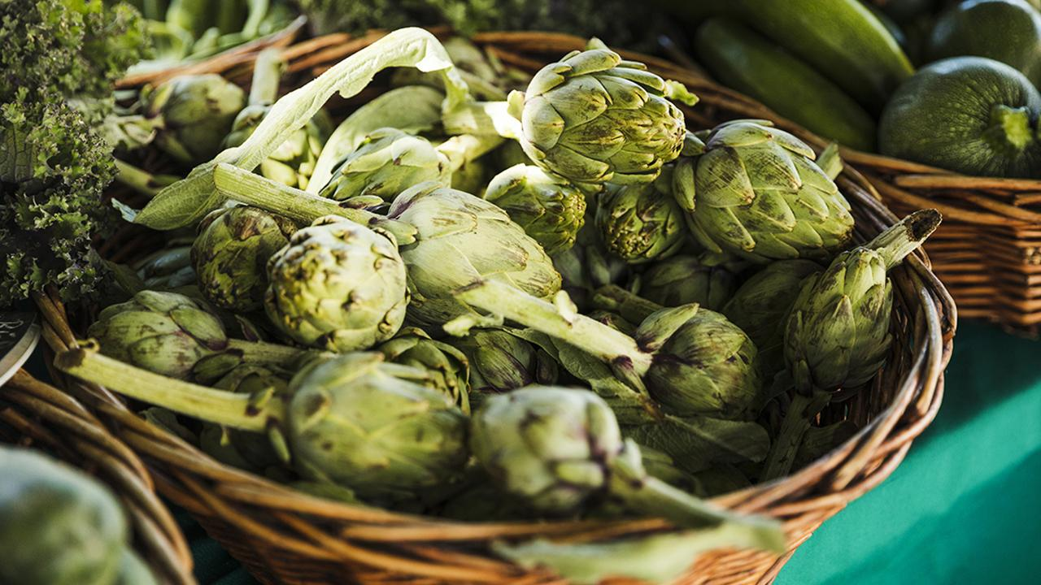
THANK YOU

